Slide 1
Java

Slide 2
Agenda Day 1
Day 1: Java Fundamentals and Object-oriented programming
Basics: Data types, variables, operators, control flow statements (if, else, for, while), methods
Object-Oriented Programming Concepts: Class, Objects, Constructors, Encapsulation, inheritance, polymorphism, abstraction
Strings and Arrays
Exception Handling: Try-catch blocks, throwing and handling exceptions, custom exceptions.
File I/O operations
Hands-on exercises

Slide 3
Various Differences between Java versions
Java 8,10,11,17
Java 17 is faster than Java 8 and 11, with a 15–18% higher throughput in Parallel and G1. It also boasts improved garbage collection and a JIT compiler that generates more efficient machine code.
Java 8 introduced lambda expressions and stream API, while Java 11 added support for Unicode 10, improved HTTP support, and removed deprecated APIs. Java 17 includes sealed classes and interfaces, pattern matching for switch statements, and the var keyword for declaring local variables.
Java 11 was the first Long Term Support (LTS) release after Java 8, and Java 17 is the current LTS version. LTS versions provide stability and long-term support.

Slide 4
Differences between Java versions
Java 8 uses Nashorn as the default JavaScript engine, while Java 11 offers new cipher implementations and cryptographic key agreement support. Java 17 also allows using null in switch cases and redefining switch statement expressions.
Java 10 and earlier are free for all uses, while Java 11 and 12 are free for personal and development uses. Java 17 and later are free for all users under an Oracle No-Fee Terms and Conditions License.

Slide 5
Basics: Data types
Java 8 has the same basic data types as previous versions. There are 8 primitive data types in Java:
byte: 8-bit signed integer (-128 to 127)
short: 16-bit signed integer (-32,768 to 32,767)
int: 32-bit signed integer (-2,147,483,648 to 2,147,483,647)
long: 64-bit signed integer (-9,223,372,036,854,775,808 to 9,223,372,036,854,775,807)
float: 32-bit single-precision floating point number
double: 64-bit double-precision floating point number
boolean: Represents true or false values
char: 16-bit Unicode character

Slide 6
Data type
int age = 30; // int type
double salary = 5000.5;// double type
char grade = 'A'; // char type
boolean isActive = true; // boolean type
String name = "Alice"; // String type

Slide 7
Variables, Operators
In Java, variables are used to store data that can be referenced and manipulated within a program. Here's a basic overview:
Declaration and Initialization
Declaration: A variable is declared with a specific data type and a name.
int age;
String name;
Initialization: Assigning a value to the variable at the time of declaration or later.
int age = 25;
String name = "John";
int age = 25;
String name = "John";
Variables can also be initialized later:
age = 30;

Slide 8
Variable Scope
Local Variables: Declared within a method or block and only accessible within that method or block.
public void display() {
int number = 5; // local variable
}
Instance Variables: Declared within a class but outside any method. They are unique to each object instance.
public class Employee {
String name; // instance variable
int age;
}

Slide 9
Variables
Class/Static Variables: Declared with the static keyword within a class but outside any method. They are shared among all instances of the class.
public class Employee {
static int employeeCount; // static variable
}
Final Variables
A variable declared with the final keyword cannot be modified after it's initialized. It effectively becomes a constant.
final int MAX_AGE = 100;

Slide 10
Variables
Type Inference with var
Java 10 introduced var, allowing the compiler to infer the type of the variable.
var age = 25; // infers int
var name = "John"; // infers String

Slide 11
Default Values
Default Values
Instance and static variables are initialized with default values if not explicitly assigned:
int - 0
double - 0.0
boolean - false
char - \u0000 (null character)
Object references (including String) - null
Local variables do not have default values and must be initialized before use.

Slide 12
Example:
// Final variable
final int CONSTANT = 100;
// Type inference
var inferredNumber = 30;
System.out.println(greeting);
System.out.println("Local Number: " + localNumber);
System.out.println("Inferred Number: " + inferredNumber);
System.out.println("Constant: " + CONSTANT);
}
}
public class Main {
// Instance variable
int number = 10;
// Static variable
static String greeting = "Hello, World!";
public static void main(String[] args) {
// Local variable
int localNumber = 20;

Slide 13
Output:
Hello, World!
Local Number: 20
Inferred Number: 30
Constant: 100

Slide 14
Control flow statements
Control flow statements in Java determine the order in which statements are executed in a program. These statements allow for decision-making, looping, and branching. Here's an overview of the main control flow statements:
1. Conditional Statements
if Statement: Executes a block of code if the specified condition is true.
int age = 18;
if (age >= 18) {
System.out.println("You are an adult.");
}

Slide 15
Control Flow Statements
if-else Statement: Executes one block of code if the condition is true, and another block if the condition is false.
if (age >= 18) {
System.out.println("You are an adult.");
} else {
System.out.println("You are a minor.");
}
else-if Ladder: Used to test multiple conditions.
if (age >= 60) {
System.out.println("Senior citizen.");
} else if (age >= 18) {
System.out.println("Adult.");
} else {
System.out.println("Minor.");
}

Slide 16
Control flow Statments
Enhanced for Loop (for-each): Specifically designed to iterate over arrays or collections.
int[] numbers = {1, 2, 3, 4, 5};
for (int num : numbers) {
System.out.println(num);
}

Slide 17
Control Statements
Branching Statements
break: Exits a loop or switch statement.
for (int i = 0; i < 10; i++) {
if (i == 5) {
break; // Exits the loop when i is 5
}
System.out.println(i);
}

Slide 18
Control flow Statements
continue: Skips the current iteration of a loop and continues with the next iteration.
for (int i = 0; i < 10; i++) {
if (i == 5) {
continue; // Skips the iteration when i is 5
}
System.out.println(i);
}

Slide 19
OOPs
Object-Oriented Programming (OOP) is a programming paradigm that uses "objects" to design software. In Java, OOP is fundamental, and understanding its core concepts is crucial for effective programming. Below are the primary OOP concepts with explanations and examples:

Slide 20
OOPs
1. Class
A class is a blueprint for creating objects. It defines the properties (attributes) and behaviors (methods) that the objects created from the class will have.
Attributes (fields or variables) represent the state of an object.
Methods define the behavior or functionality of an object.
public class Car {
// Attributes
String model;
String color;
int year;
// Method
void startEngine() {
System.out.println("The engine is starting..."); } }
Here, Car is a class with attributes like model, color, and year, and a method startEngine().

Slide 21
OOPs
Objects
An object is an instance of a class. It is created from the class blueprint and can access the attributes and methods defined in the class.
public class Main {
public static void main(String[] args) {
// Creating an object of the Car class // In this example, myCar is an object of the Car class.
Car myCar = new Car();
myCar.model = "Tesla Model S";
myCar.color = "Red";
myCar.year = 2023;
// Accessing the method
myCar.startEngine(); } }

Slide 22
OOPs
Encapsulation:
Concept: Encapsulation is the process of bundling data (attributes) and methods that operate on the data into a single unit or class, and restricting access to the internals of that class. It focuses on controlling access to the object's data.
Purpose: To protect the object's integrity by preventing external code from directly accessing or modifying its internal state.
Implementation: Achieved by using access modifiers (private, protected, public) to restrict access to the class's fields and methods.
Abstraction:
Concept: Abstraction is the process of hiding the complex implementation details and showing only the essential features of an object or concept. It focuses on what an object does rather than how it does it.
Purpose: To reduce complexity by exposing only the relevant details and hiding the internal workings.
Implementation: Achieved through abstract classes and interfaces in Java.

Slide 23
OOPs
Purpose
Abstraction:
Goal: To simplify the interaction with complex systems by providing a clear and simple interface.
Example: An interface Shape with a method draw() that various shapes like Circle, Square, etc., implement. Users of the interface don't need to know how each shape's draw() method is implemented, only that they can call draw() on any shape.
Encapsulation:
Goal: To safeguard the data and ensure that objects maintain a consistent and valid state by controlling how they are accessed and modified.
Example: A Car class has private attributes like engine and speed. Public methods like startEngine() and accelerate() allow interaction with these attributes, but the internal details of how the engine starts or how speed is calculated are hidden from the outside world.

Slide 24
Exception Handling
What is an Exception?
An exception is an event that occurs during the execution of a program that disrupts the normal flow of instructions. In Java, exceptions are objects that represent these error conditions.

Slide 25
Exception Handling
Types of Exceptions
Java exceptions are categorized into three main types:
Checked Exceptions: Exceptions that are checked at compile-time. These exceptions must be either caught or declared in the method signature using throws. For example, IOException, SQLException.
Unchecked Exceptions: Exceptions that are not checked at compile-time. These exceptions are subclasses of RuntimeException, and handling them is optional. For example, NullPointerException, ArrayIndexOutOfBoundsException.
Errors: These are serious issues that a typical application should not try to catch, as they usually indicate problems that are external to the application or the Java environment itself, like OutOfMemoryError, StackOverflowError.

Slide 26
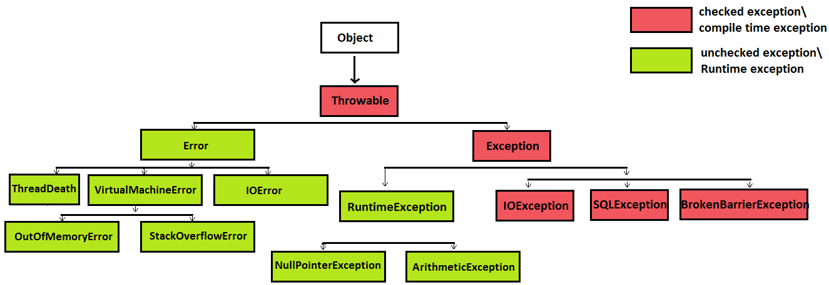
Exception hierarchy

Slide 27
Exception Handling
Try-Catch Block
The try-catch block is used to catch exceptions and handle them appropriately.
Try Block: Contains code that might throw an exception.
Catch Block: Handles the exception if one occurs in the try block.

Slide 28
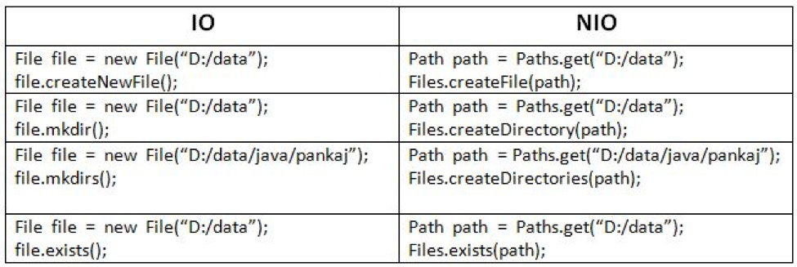
Java File IO

Slide 29
Java File IO
Java Files class contains static methods that work on files and directories.
This class is used for basic file operations like create, read, write, copy and delete the files or directories of the file system.
Before move ahead let’s have a look at the below terms first:
Path: This is the interface that replaces java.io.File class as the representation of a file or a directory when we work in Java NIO.
Paths: This class contains a static method to create Path instance.
java.nio.file.Path interface is just like the old java.io.File class. Path represents location of the file and when we create a Path to new file, it does not create actual file until we create it using Files.createFile(Path filePath).

Slide 30
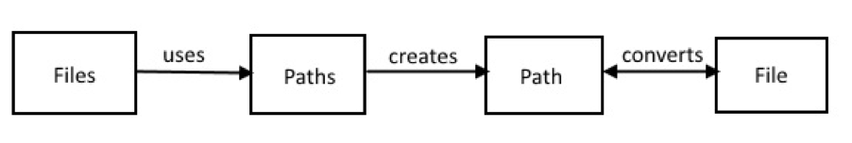
Java File IO
Paths class is used to create instance of Path and Files class uses Path instance to work on a file. File and Path objects know how to convert to the other, that’s how we can use older code to interact with new Files utility.

